Slide 1
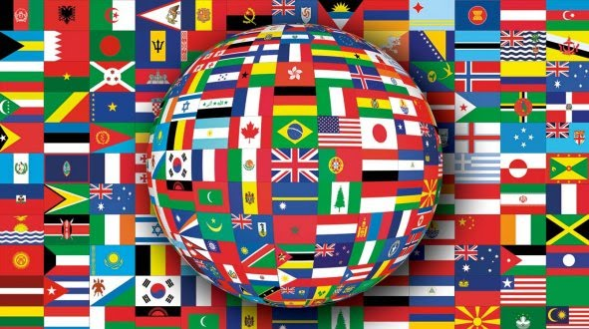
SOCIAL STUDIES
GLOBAL INTERACTIONS

Slide 2
BIG QUESTIONS:
How are we connected with each other?
What are the challenges and benefits of cultural diversity?
How do cultural values and beliefs influence people’s lives?
How does immigration affect people’s lives?
How are we affected by cultural change?
How does diversity contribute to global interdependence?

Slide 3
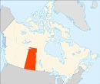
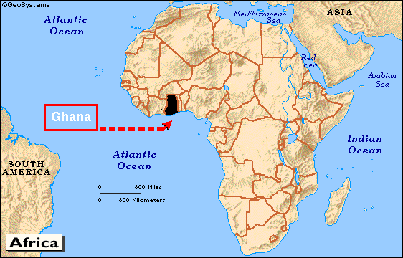
Where we live affects the foods we eat, the clothing we wear, the shelter we need, how we travel, and the sports we play. Living in Saskatchewan is very different to living in a country like Ghana, and so our lives are very different.

Slide 4
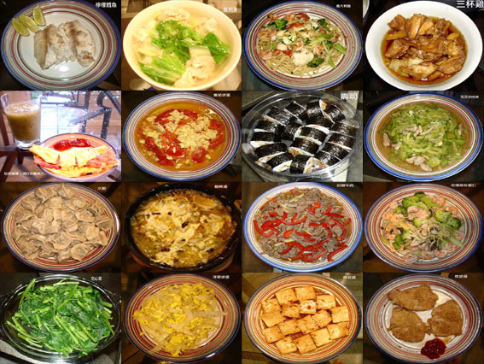
Where we live also affects our beliefs and what we think is important (our values). For example, if you were very poor, you might think food is more
valuable than if you always had a lot of
food.

Slide 5
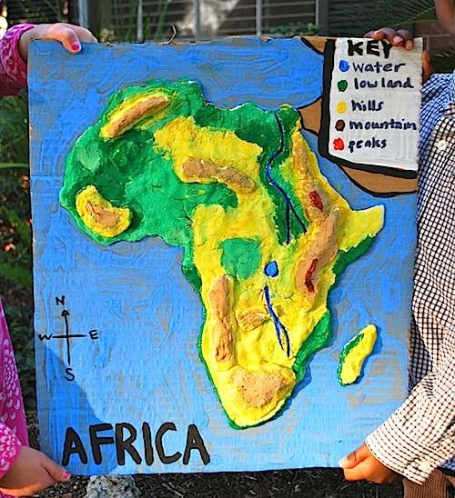
We can use maps to give us a lot of information. Some tell us about climate, others about the geography of a place (hills, rivers, etc), others can tell us about religions or different kinds of farming. Knowing about different countries’ geography and climate is important because it affects us!

Slide 6
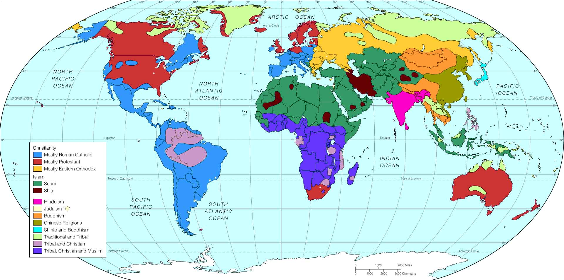
Our food comes from different places, we might want to travel there, it helps us understand why people live the way they do, and understand what people believe and how they live.

Slide 7
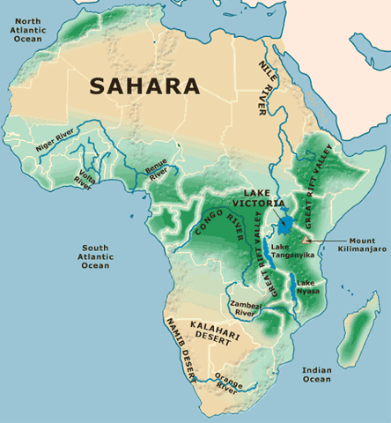
When we look at a map, we can make some guesses about what people’s lives are like based on the geography. For example, if people live in a very arid region, we can guess that farming would be very difficult.

Slide 8
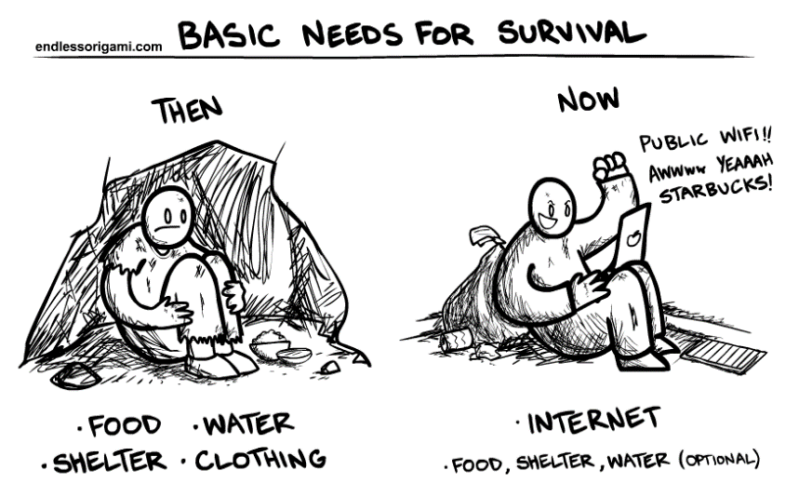
Culture is a learned way of living, including language, beliefs, arts, sports and foods, that are shared by a group of people. All people have the same basic needs, such as food, water, clothing, and shelter, but different cultures respond to their needs and wants in different ways. These are learned within families and communities, and also from media, school and different groups.

Slide 9
Cultures can change over time, and have both benefits and drawbacks. For example, introducing technology can improve people’s quality of life. Introducing new kinds of sugary food can change the lifestyle of people and damage their health. Culture can change as people move from place to place and learn from each other.

Slide 10
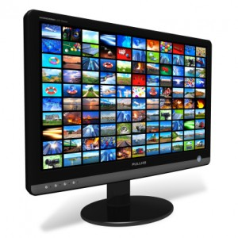
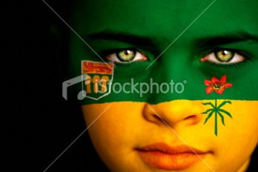
Technology also allows cultures to spread as people can easily watch movies or tv from different cultures on the internet.
Saskatchewan is a multicultural province. We celebrate the value of diverse cultures in Saskatchewan.

Slide 11
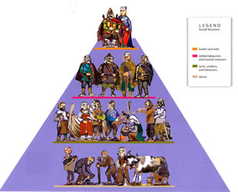
A society is a group of people who have organized themselves to meet their basic needs. A social structure is how people relate to each other. People have many different roles within a society. A person could be a daughter, friend, sister, aunt, cousin, student, soccer player and expert yo-yo player all at once! A community needs each person to do their role.

Slide 12
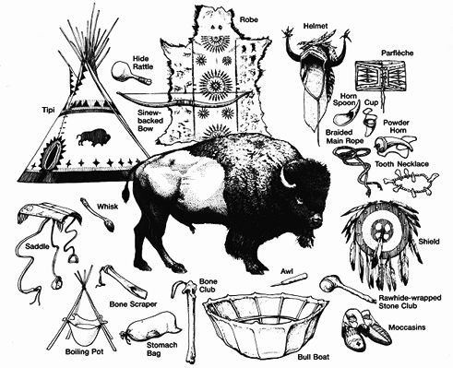
They way societies function can change because of events (for example, SK changed dramatically when European settlers moved here. The First Nation People’s lives changed as the buffalo were killed and their land was used for farmland.)

